Slide 1
CAPSTONE PROJECT
TEAM - 1
TEAM MEMBERS:
Vishnu Sathyan
Arjun Shilin
Augustine
Mohammad Faiz
Parvathy Madhu
Aryamol Ashokan

Slide 2
TABLE OF CONTENTS
01
02
03
04
05
DOCUMENT CREATION
protractor
selinium
integraction
Jenkins
Write test plan, test strategy ,test case for deals of the week module in urbanladder.com
Test the module deals of the week using protractor
Selenium web driver testcases to locate the elements of Urban ladder webpages. To depict the wait, sleep during the implementation
Cucumber + TestNG + Selenium integration to test the module of urban ladder. To imbibe the lighthouse or google axe tools.
Jenkins+selinium integration to check the module deals of the week in urban Ladder website
2

Slide 3
TABLE OF CONTENTS
06
07
08
09
10
Aws + jmeter
restassurd
MOBILE TESTING
SELINIUM + AWS
Python
Performance check for the module of urban ladder using JMeter on AWS cloud
API testing on sample spring boot application using rest assured
To depict Appium + selenium for mobile testing(Android) using emulator
Integrating aws with selinium to test the module deals of the week of urban Ladder website
Selinium web driver automation testing using Python
3

Slide 4
Task 1
Write test plan, test strategy ,test case for deals of the week module in urbanladder.com

Slide 5
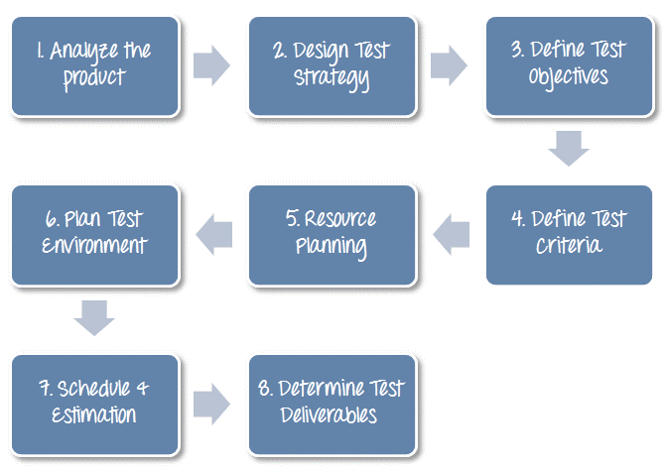
TEST PLAN
Detailed document that describes the test strategy, objectives, schedule, estimation, deliverables, and resources required to perform testing for a software product
Notes:
https://www.guru99.com/what-everybody-ought-to-know-about-test-planing.html

Slide 6
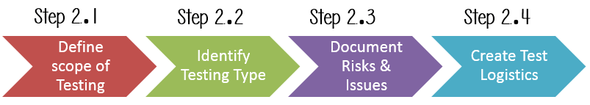
TEST STRATEGY
Well-described document in software testing which clearly defines the exact software testing approach and testing objectives of the software application.

Slide 7
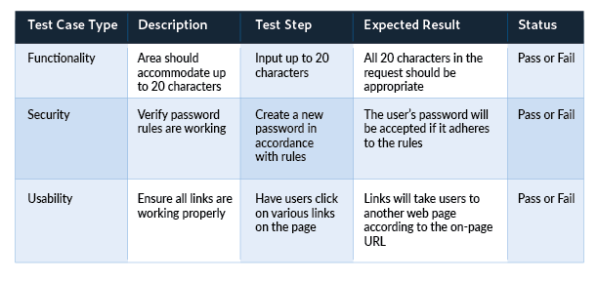
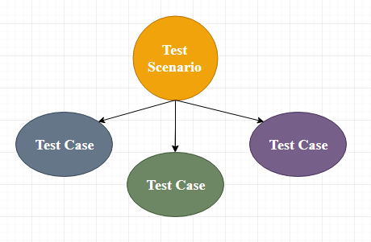
TEST CASE
Set of actions executed to verify a particular feature or functionality of the software application.

Slide 8
Task 2
Test the module deals of the week using protractor

Slide 9
PROTRACTOR
Protractor is a wrapper around Selenium Web driver that provides an automation test framework, which simulates user interaction with an Angular web application
Protractor needs two files to run, a spec file and configuration file.
Configuration file: This File helps protractor to where the test files are placed (specs.js) and to talk with Selenium server (Selenium Address). Chrome is the default browser for Protractor.
Spec file: This File contains the logic and locators to interact with the application.

Slide 10
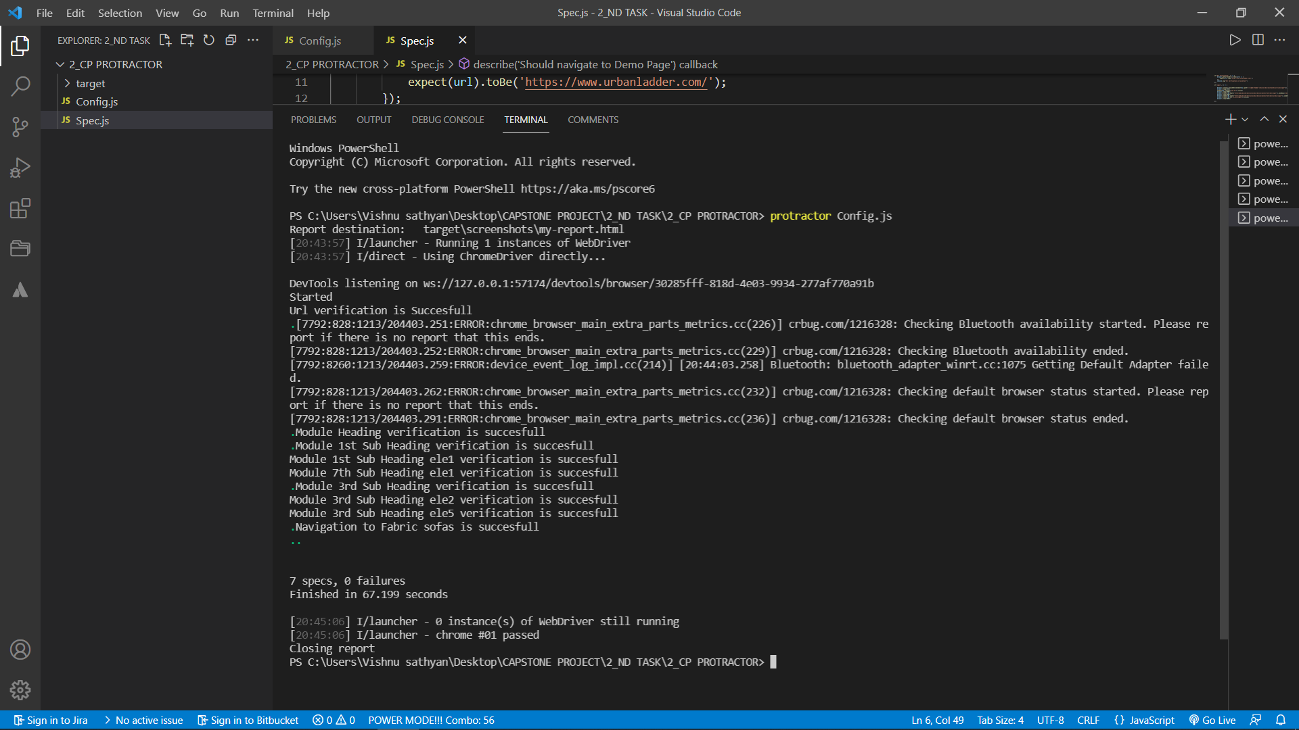

Slide 11
Task 3
Selenium web driver testcases to locate the elements of Urban ladder webpages. To depict the wait, sleep during the implementation

Slide 12
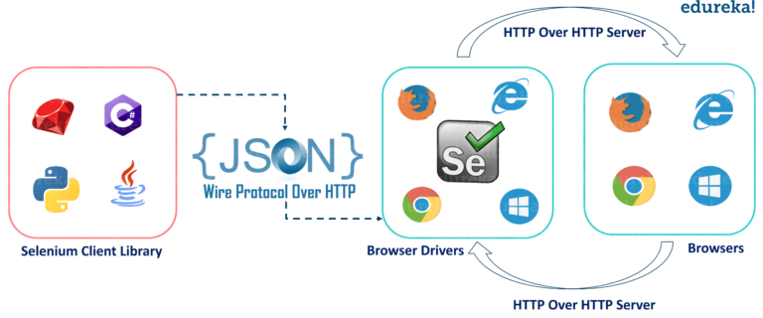
SELENIUM
Selenium is a free (open-source) automated testing framework used to validate web applications across different browsers and platforms. You can use multiple programming languages like Java, C#, Python etc. to create Selenium Test Scripts

Slide 13
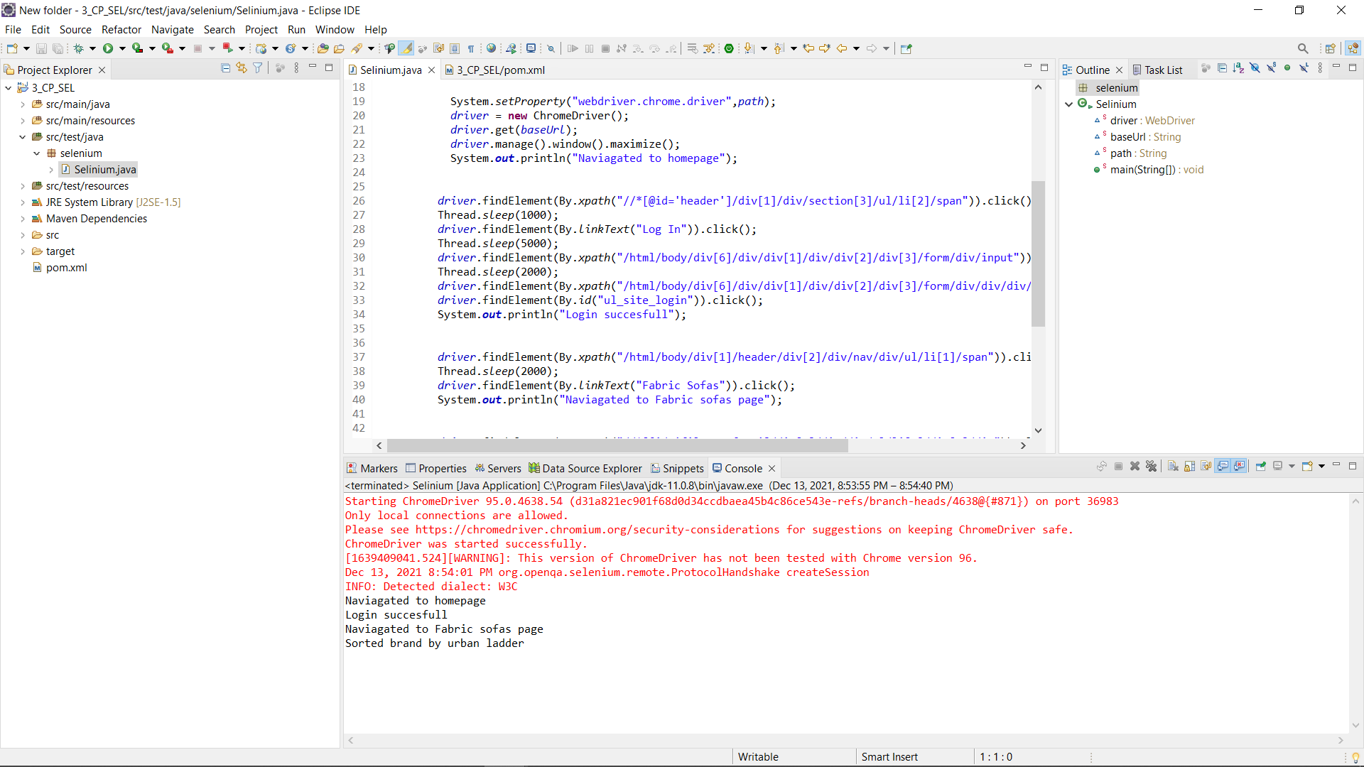

Slide 14
Task 4
Cucumber + TestNG + Selenium integration to test the module of urban ladder. To imbibe the lighthouse or google axe tools.

Slide 15
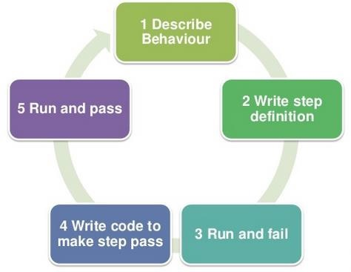
CUCUMBER
Cucumber is a software tool used by the testers to develop test cases for testing the behavior of the software.(BDD TOOL)3
In the Cucumber testing, the test cases are written in a simple English text, which anybody can understand without any technical knowledge. This simple English text is called the Gherkin language.

Slide 16
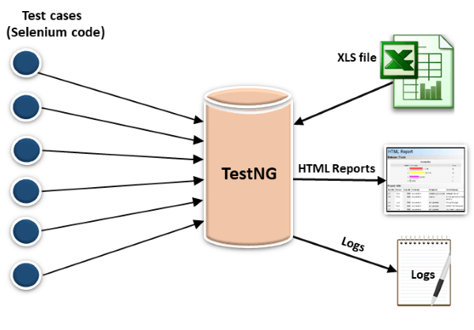
TESTNG
TestNG provides full control over the test cases and the execution of the test cases. Due to this reason, TestNG is also known as a testing framework.

Slide 17
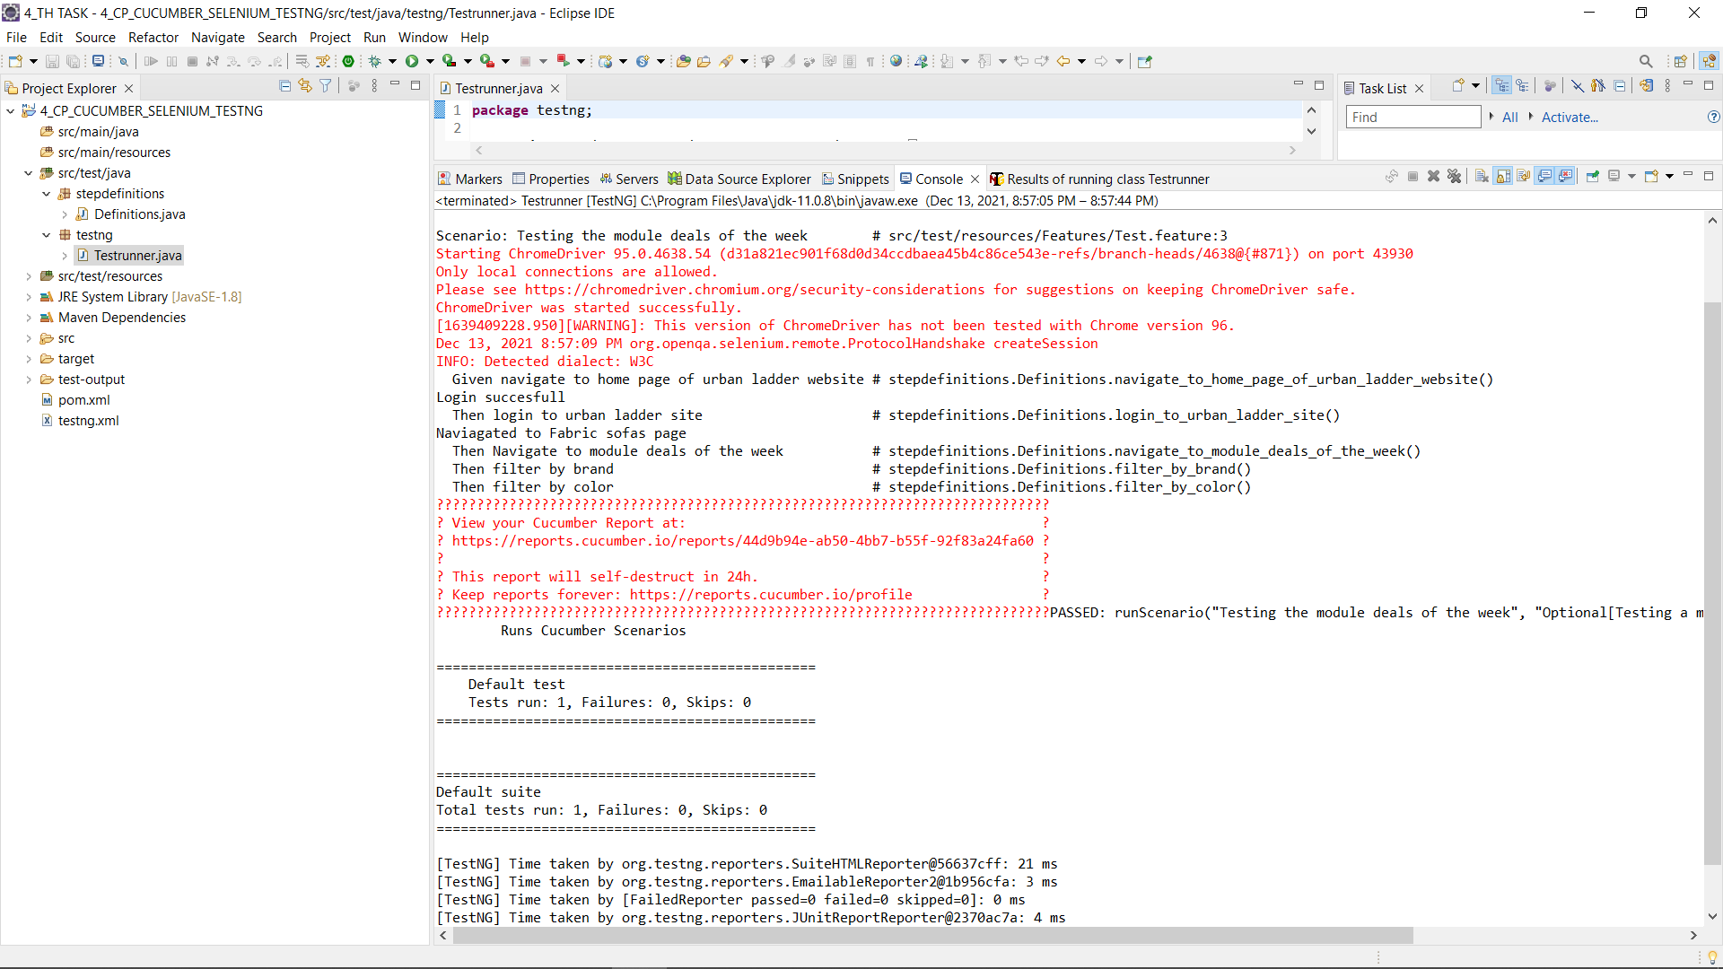

Slide 18
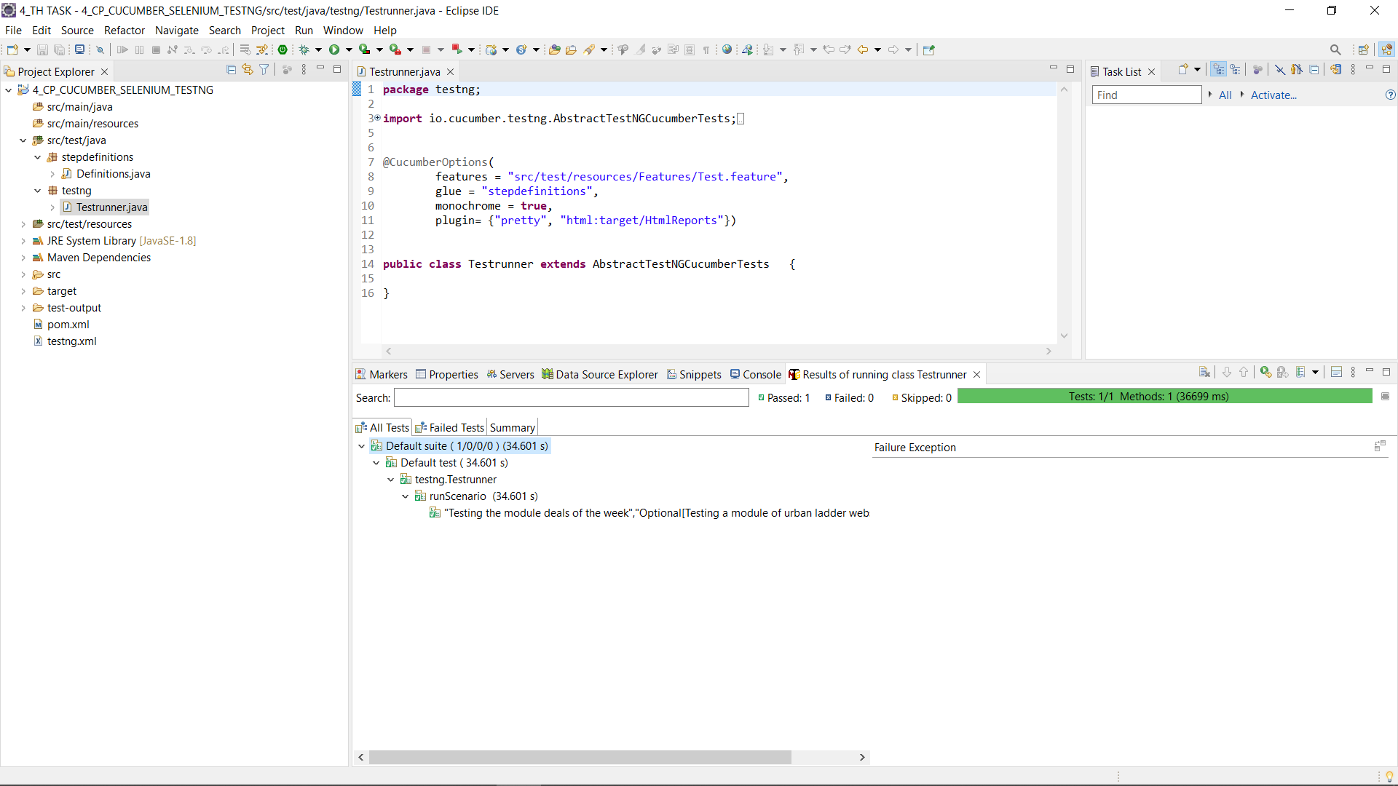

Slide 19
Task 5
Jenkins+selinium integration to check the module deals of the week in urban Ladder website

Slide 20

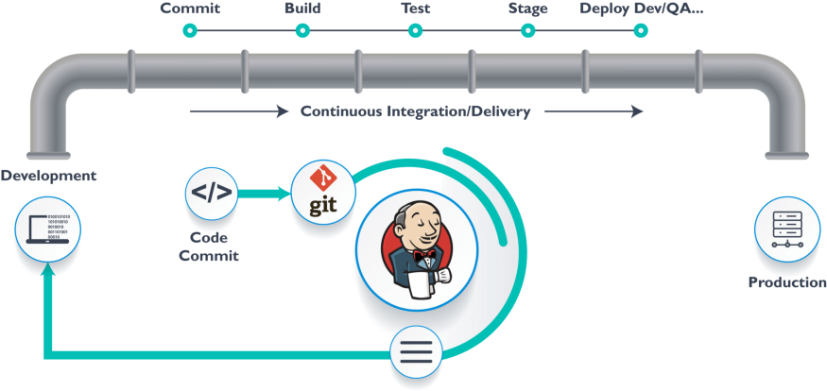
JENKINS
Jenkins is an open source continuous integration/continuous delivery and deployment (CI/CD) automation software DevOps tool written in the Java programming language. It is used to implement CI/CD workflows, called pipelines.

Slide 21
Task 6
Performance check for the module of urban ladder using JMeter on AWS cloud

Slide 22
JMETER ON AWS
Apache JMeter is pure Java-based open-source software designed to load test functional behavior and measure performance.
JMeter can be also used to analyze and measure the performance of web applications or a variety of services.
Amazon web service is an online platform that provides scalable and cost-effective cloud computing solutions.
AWS is a broadly adopted cloud platform that offers several on-demand operations like compute power, database storage, content delivery, etc., to help corporates scale and grow

Slide 23
Task 7
API testing on sample spring boot application using rest assured

Slide 24
REST ASSURED
one of the most used library for REST API Automation Testing.
Rest-Assured is a Java-based library that is used to test RESTful Web Services. This library behaves like a headless Client to access REST web services.
Rest-Assured library also provides the ability to validate the HTTP Responses received from the server
we can verify the Status code, Status message, Headers and even the Body of the response.

Slide 25
Task 8
To depict Appium + selenium for mobile testing(Android) using emulator

Slide 26
APPIUM
APPIUM is a freely distributed open source mobile application UI Testing framework
Appium allows native, hybrid and web application testing and supports automation test on physical devices as well as an emulator or simulator both.
It offers cross-platform application testing, i.e. single API works for both Android and iOS platform test scripts.

Slide 27
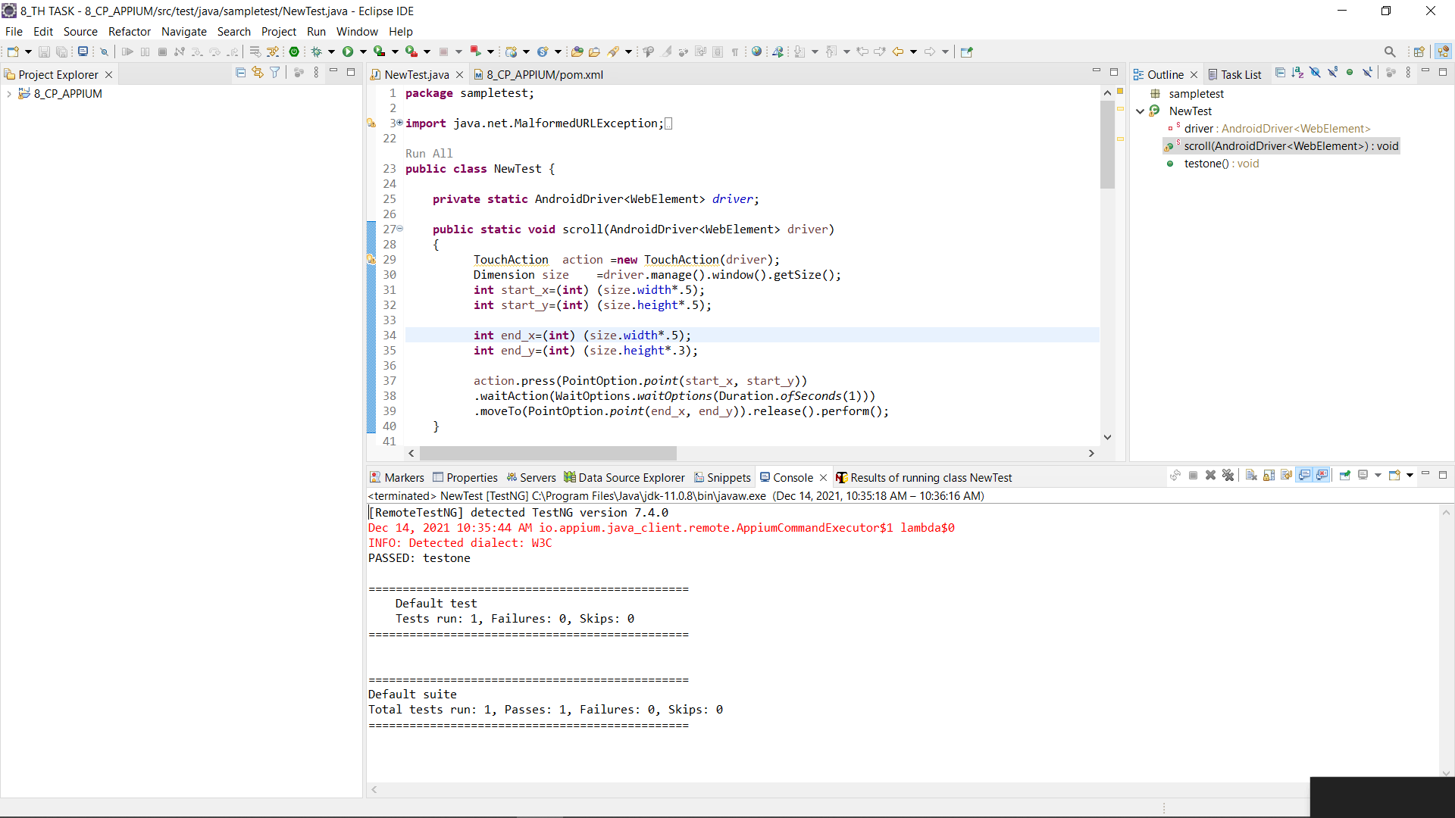

Slide 28
Task 9
Integrating aws with selinium to test the module deals of the week of urban Ladder website

Slide 29
Task 10
Selinium web driver automation testing using Python

Slide 30
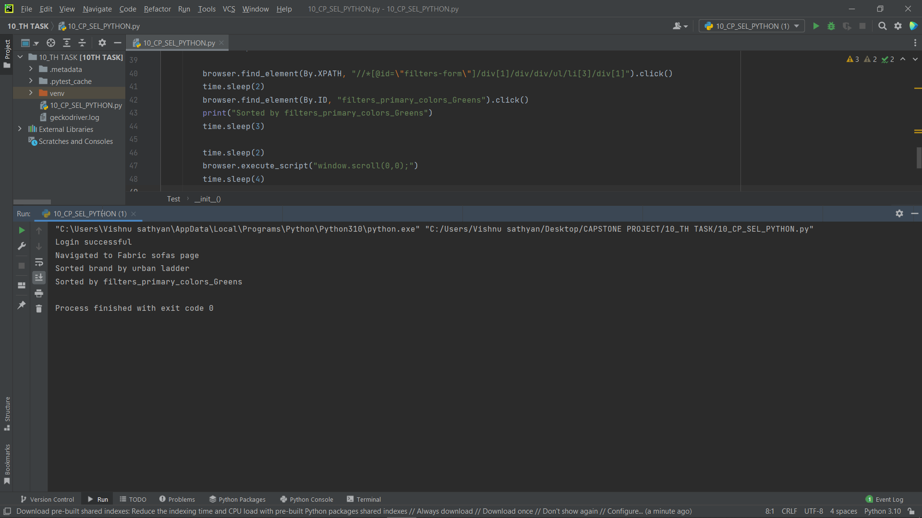

Slide 31
Reference
GitHub link to reference the code related to different tasks

Slide 32

GitHub link
Click here

Slide 33
Thank You 1

